Slide 1
How binary is our Future? - The Transformation of Man and Machine.

Slide 2
Agenda
1
2
3
4
5
Digitization &
Digitalization
Machine Learning
Blockchain
Industry 4.0
Q&A
Questions!
Answers?

Slide 3
Agenda
1
2
3
4
5
Digitization &
Digitalization
Machine Learning
Blockchain
Industry 4.0
Q&A
Questions!
Answers?

Slide 4
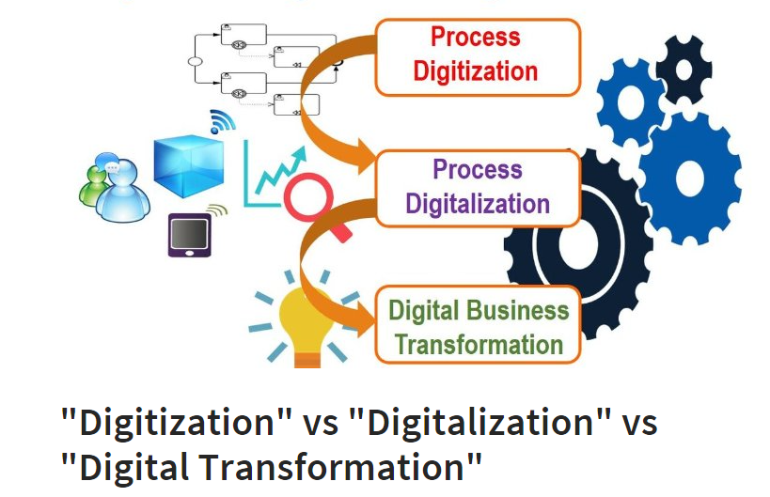
Digitization and Digitalization
“Customers want a quick and seamless digital experience, and they want it now ”
“Customers have been spoiled. Thanks to companies such as Amazon and Apple…”
“Digitization is the automation of existing manual and paper-based processes, enabled by the digitization of information; from an analogue to a digital format.”
Quelle: https://www.linkedin.com/pulse/digitization-vs-digitalization-digital-transformation-bpm
from “Accelerating the digitization of business processes” by Shahar Markovitch and Paul Willmott
Notes:
Einstieg ins Thema mit den o.g. Zitaten
Der Kunde fordert….
Digitalisierung ist ein Trendthema und Projektmanagement dabei von großer Bedeutung
Digitaler Wandel
menschlicher Aspekt der Digitalisierung "Der Faktor Mensch im globalen Highspeed" wie man Veränderungen des digitalen Wandels am besten meistern kann.

Slide 5
Digitization and Digitalization
Why? Customer-Expectations:
Quick delivery of products
Swiftly services
seamless user experience
online accounts
real-time reports
Need of Radical efficient business processes:
Intuitive interfaces
around-the-clock availability
real-time fulfilment
personalized treatment
global consistency, and zero errors
competitive prices because of lower costs
better operational controls, and less risk.
Quelle: https://www.mckinsey.com/business-functions/digital-mckinsey/our-insights/accelerating-the-digitization-of-business-processes
Notes:
Zusammenfassung Warum Digitization und Digitalisierung?
Erwartungen der Kunden, erfordern eine rasante Digitalisierung der Prozesse
Es ergibt sich ein Bedarf an “neuen” effizienten Prozessen

Slide 6
Digitization and Digitalization
What is Digitization?
Digitization defined in the context of processes
In the context of ‘physical information carriers’, such as paper documents or analogue, printed images, we mainly digitize by using document scanners in business (or simply scan or take a picture with your mobile). →Digitization is the transformation from analogue to digital or digital representation of a physical item with the goal to digitize and automate processes or workflows.
What is Digitalization?
Digitalization means the use of digital technologies and of data (digitized and natively digital) in order to create revenue, improve business, replace/transform business processes (not simply digitizing them) and create an environment for digital business, whereby digital information is at the core.
Quelle: https://www.mckinsey.com/business-functions/digital-mckinsey/our-insights/accelerating-the-digitization-of-business-processes
Notes:
Erklärung der Begriffe: There is no digitalization and no digital transformation without digitization (of paper and processes)
Digitization is used in several meanings as said but for me it has two meanings which are closely related with each other.
For starters, digitization is creating a digital (bits and bytes) version of analog/physical things such as paper documents, microfilm images, photographs, sounds and more.
Beispiel: if you take a picture of a building you have a digitally born representation of the building but the building is not digitized or you might have an analog picture which you scan so it is digitized).
In conclusion: digitization is digitization. Period. Digitization is the automation of existing manual and paper-based processes, enabled by the digitization of information; from an analog to a digital format.

Slide 7
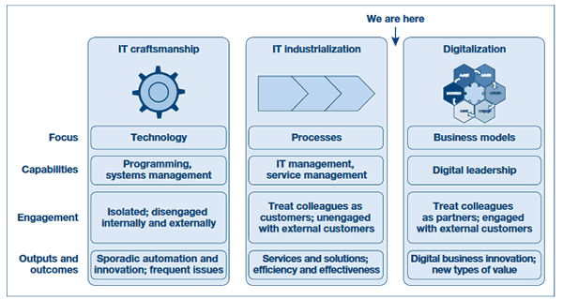
Digitization and Digitalization
Quelle: https://www.i-scoop.eu/digitization-digitalization-digital-transformation-disruption/
Notes:
Grafische Einordnung

Slide 8
Digitization and Digitalization
Digitalization leads to digital business, digital transformation requires digital business and digitization
Reinvent entire business processes
Reducing documents
Automated decision making
Redesign of roles and structures
Data Models
Performance tracking
Training
Benefits
Cutting the costs
Saving time
Automatic collect data
Process performance
Real time reports
Supply-chain-quality
Monitoring customer behaviour and feedback
Building in-house capabilities
Quelle: https://www.i-scoop.eu/digitization-digitalization-digital-transformation-disruption/

Slide 9
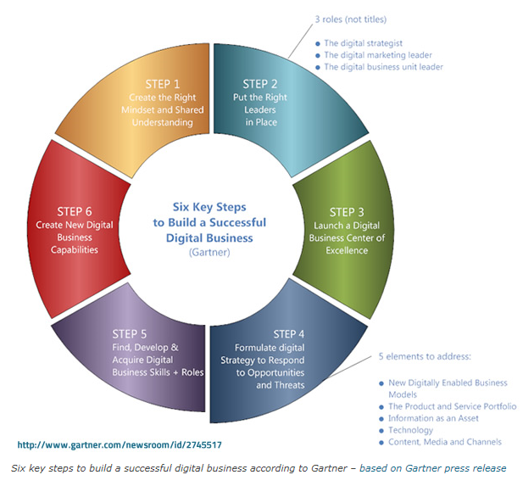
Digitization and Digitalization
Notes:
Summarizing you can say that digital transformation requires digitalization ‘en route’ to digital business (capabilities) and requires digitization, since the glue and a core business asset of digital transformation (and of digitalization) is obviously (digital) data, leading to information, knowledge, intelligence, action and business model changes.
Digitization in one sentence? Digitization is the transformation from analog to digital or digital representation of a physical item with the goal to digitize and automate processes or workflows.

Slide 10
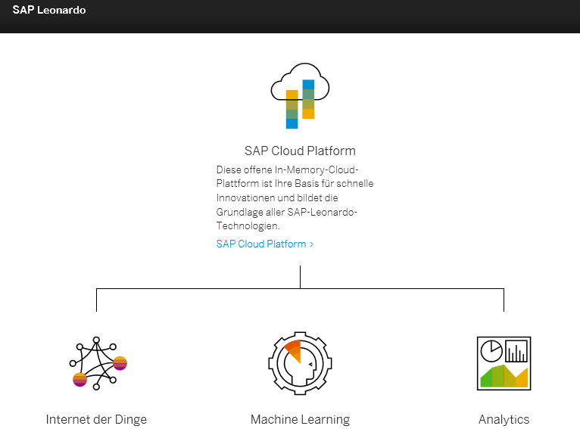
Digitalization – with ERP, e.g. SAP
Notes:
integrierte Lösung SAP Leonardo

Slide 11
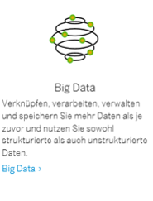
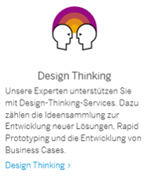
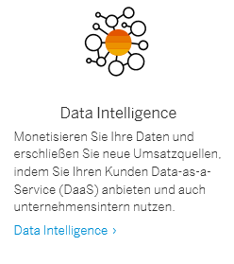
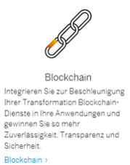
Digitalization

Slide 12
1
2
3
4
5
Digitization &
Digitalization
Machine Learning
Blockchain
Industry 4.0
Q&A
Questions!
Answers?

Slide 13
Machine Learning
https://www.youtube.com/watch?v=_pILDol6X-Q
https://www.youtube.com/watch?v=TBF7EE2xnN4
https://www.youtube.com/watch?v=IS8T71kUgWo
Notes:
Videos online streamen!
Minute 21-ca.25 von https://www.youtube.com/watch?v=fpDUiDQigO
https://www.youtube.com/watch?v=_pILDol6X-Q
https://www.youtube.com/watch?v=TBF7EE2xnN4
https://www.youtube.com/watch?v=IS8T71kUgWo

Slide 14
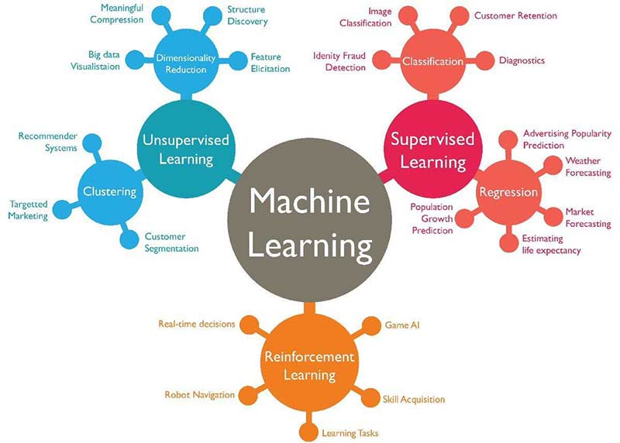
Machine Learning
https://www.techleer.com/articles/203-machine-learning-algorithm-backbone-of-emerging-technologies/

Slide 15
Machine Learning
Machine learning is a field of computer science that gives computers the ability to learn without being explicitly programmed. (1959 by Arthur Samuel)
Categorization of machine learning tasks classification inputs are divided into two or more classes, and the learner must produce a model that assigns unseen inputs to one or more (multi-label classification) of these classes.
regression, also a supervised problem, the outputs are continuous rather than discrete.
clustering, a set of inputs is to be divided into groups. Unlike in classification, the groups are not known beforehand, making this typically an unsupervised task.
Density estimation finds the distribution of inputs in some space
Dimensionality reduction simplifies inputs by mapping them into a lower-dimensional space.
Topic modelling is a related problem, where a program is given a list of human language documents and is tasked to find out which documents cover similar topics

Slide 16
1
2
3
4
5
Digitization &
Digitalization
Machine Learning
Blockchain
Industry 4.0
Q&A
Questions!
Answers?

Slide 17
Blockchain Technology
What is Blockchain? Blockchain is a distributed database that holds records of digital data or events in a way that makes them tamper-resistant. While many users may access, inspect, or add to the data, they can’t change or delete it. The original information stays put, leaving a permanent and public information trail, or chain, of transactions.
How will Blockchain Technology Affect the Supply Chain?
blockchain technology allows us to more securely and transparently track all types of transactions
Every time a product changes hands, the transaction could be documented
creating a permanent history of a product, from manufacture to sale
dramatically reduce time delays, added costs, and human error that plague transactions today.
Recording the quantity and transfer of assets - like pallets, trailers, containers, etc. - as they move between supply chain nodes (Talking Logistics)
Tracking purchase orders, change orders, receipts, shipment notifications, or other trade-related documents
Assigning or verifying certifications or certain properties of physical products; for example determining if a food product is organic or fair trade (Provenance)
Linking physical goods to serial numbers, bar codes, digital tags like RFID, etc.
Sharing information about manufacturing process, assembly, delivery, and maintenance of products with suppliers and vendors
Quelle: https://www.newsbtc.com/2018/01/14/blockchain-technology-is-changing-the-logistics-industry/
http://www.supplychain247.com/article/why_blockchain_is_a_game_changer_for_the_supply_chain

Slide 18
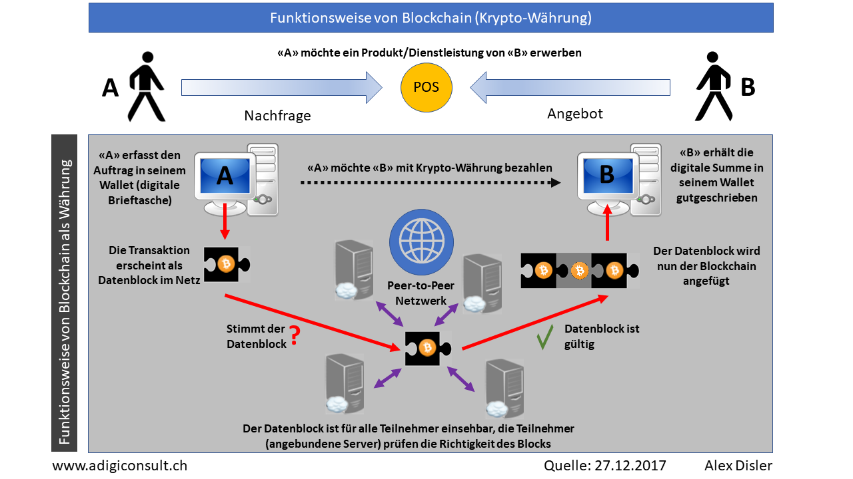
Blockchain Technology

Slide 19
Blockchain Technology
Benefits in a Nutshell - blockchain’s potential.
Regardless of the application, blockchain offers the following advantages:
Enhanced Transparency. Documenting a product’s journey across the supply chain reveals its true origin and touchpoints, which increases trust and helps eliminate the bias found in today’s opaque supply chains. Manufacturers can also reduce recalls by sharing logs with OEMs and regulators (Talking Logistics).
Greater Scalability. Virtually any number of participants, accessing from any number of touchpoints, is possible (Forbes).
Better Security. A shared, indelible ledger with codified rules could potentially eliminate the audits required by internal systems and processes (Spend Matters).
Increased Innovation. Opportunities abound to create new, specialized uses for the technology as a result of the decentralized architecture.
https://www.newsbtc.com/2018/01/14/blockchain-technology-is-changing-the-logistics-industry/

Slide 20
1
2
3
4
5
Digitization &
Digitalization
Machine Learning
Blockchain
Industry 4.0
Q&A
Questions!
Answers?

Slide 21
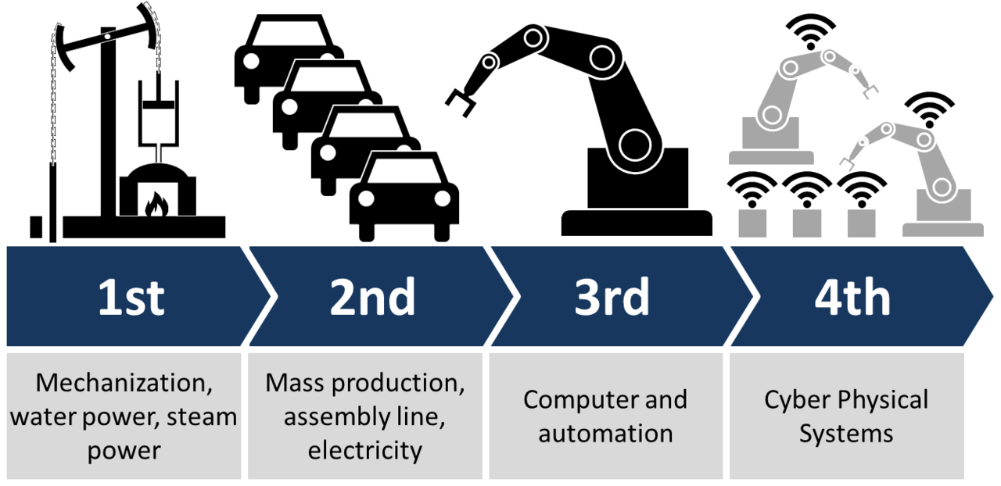
Industry 4.0
Definition:
Industry 4.0 is a name for the current trend of automation and data exchange in manufacturing technologies. It includes cyber-physical systems, the Internet of things, cloud computing and cognitive computing. Industry 4.0 is commonly referred to as the fourth industrial revolution.
Quelle: https://en.wikipedia.org/wiki/Industry_4.0

Slide 22
Industry 4.0
Deutsch: https://www.youtube.com/watch?v=ILkWFzdfpwY
English: https://www.youtube.com/watch?v=MZkY9HNCiM0
Notes:
Video ca 6 min

Slide 23
Industry 4.0
Technology Roadmap
From both strategic and technological perspectives, the Industry 4.0 roadmap visualizes every further step on the route towards an entirely digital enterprise. In order to achieve success in the digital transformation process, it is necessary to prepare the technology roadmap in the most accurate way.
Driven by:
digital transformation in vertical/horizontal value chains and product/service offerings of the companies.
Required key technologies for Industry 4.0 transformation:
internet of things
machine learning
cloud systems
Data Intelligence
Cybersecurity
adaptive robotics
Blockchain
Big data analytics consists of 6Cs in the integrated Industry 4.0 and cyber physical systems environment.
Connection (sensor and networks)
Cloud (computing and data on demand)
Cyber (model & memory)
Content/context (meaning and correlation)
Community (sharing & collaboration)
Customization (personalization and value)
Quelle: https://en.wikipedia.org/wiki/Industry_4.0#Technology_Roadmap_for_Industry_4.0
Quelle: https://en.wikipedia.org/wiki/Industry_4.0

Slide 24
1
2
3
4
5
Digitization &
Digitalization
Machine Learning
Blockchain
Industry 4.0
Q&A
Questions!
Answers?

Slide 25
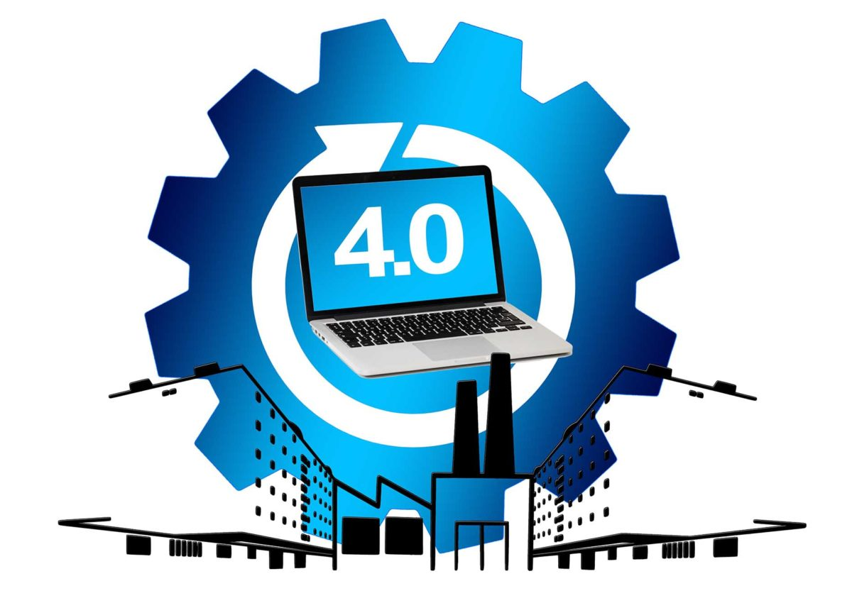
Thank you!
https://smart-place.net/world-economic-forum-transformation-der-produktion-schafft-ungleichgewichte-5041/

